Slide 1
Hospital Operations and Patient Flow Analytics
Presented by: Victoria Ademijube
DataHer Analytics Challenge

Slide 2
Business Questions
Why are waiting times increasing?
Which departments experience the longest delays?
Which days are busiest?
Are more doctors needed?
Which patients wait the longest?
Which departments receive the poorest feedback?

Slide 3
Methodology
Tools Used:
Excel/Power query – data cleaning
Power BI – data analytics/visualization
Chat GPT- troubleshooting, brainstorming

Slide 4
Core KPIs
501
PATIENTS
2,000
APPOINTMENTS
25
DOCTORS
21 Mins
AVGERAGE WAIT TIME
3.0
AVERAGE RATING
40 Mins
MAX WAIT TIME

Slide 5
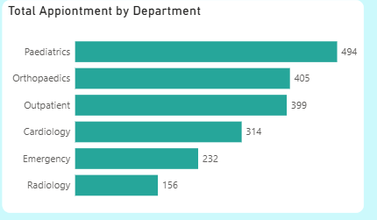
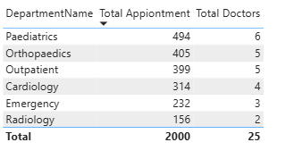
Data Insights (Appointments Flow and Capacity Allocation)
Paediatrics recorded 494 appointments
This is followed by Orthopaedics (405).
These three departments account for about 65% of all appointments.
Departmental workload is relatively balanced.
However, this is not enough to determine whether more doctors are needed.

Slide 6
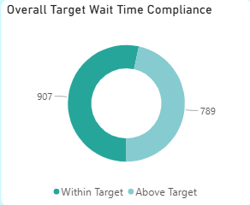
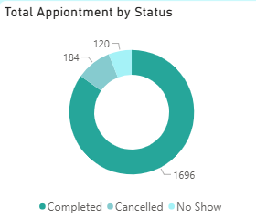
Data Insights
More than 45% (789) of the completed appointments did not meet the department-specific waiting time target.
This is still a large percentage.
1,696 appointments were completed.
184 cancellations and 120 no-shows.

Slide 7
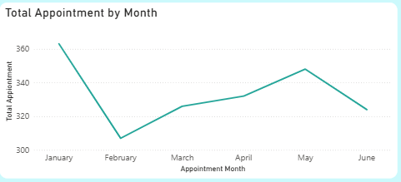
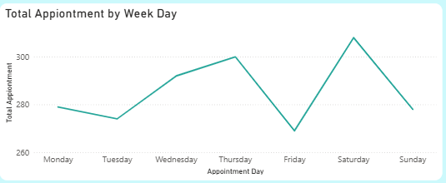
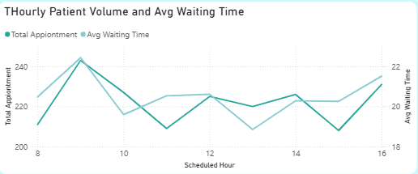
Data Insights (Monthly and Hourly patterns)
January is the busiest month (363 appointments)
February is the lowest (307).
Demand rises again through May before easing in June.
Saturday is the busiest day (308)
Friday is the lowest (269).
Appointment volume (240) peaks at 9am
This is similar to average wait time at 9am. (However, the average wait time fluctuates from 19-22 mins).

Slide 8
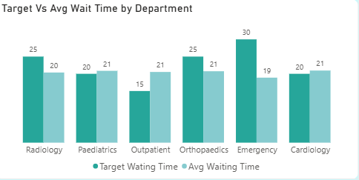
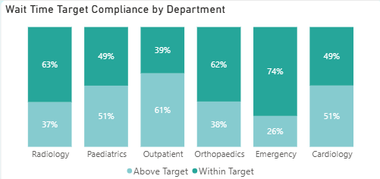
Data Insights (Department-level waiting-time performance)
Outpatients shows the greatest concern.
Emergency has the strongest compliance with its target.
However, its target wait time should be assessed, given the urgent nature of emergency care.
Outpatient: highest above-target appointments (61%)
Emergency: lowest above-target appointments (26%)

Slide 9
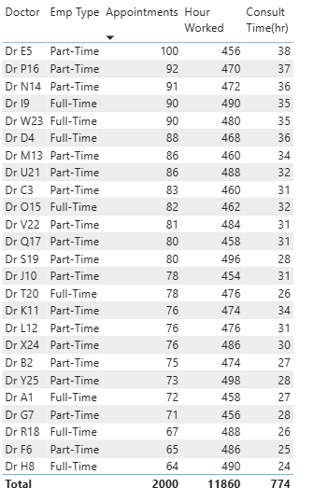
Data Insights (Doctors Workload and Availability)
Workload is uneven
Varying from 64 -100 appointment
Dr E5: highest workload / part-time
Dr H8: lowest workload/ full-time
Scheduled capacity for each doctor ranges from 450-496 hours.
However, recorded consultation duration was only 24-37 hours per doctor.
Only a small portion of their scheduled working time was spent in recorded consultation.
The remaining working hours may be spent on other clinical duties such as ward rounds.
Long wait time may be driven by workflow factors or unrecorded activities.

Slide 10
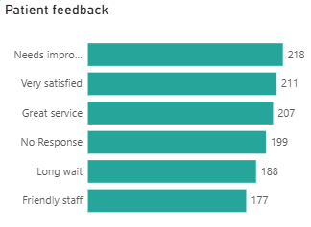
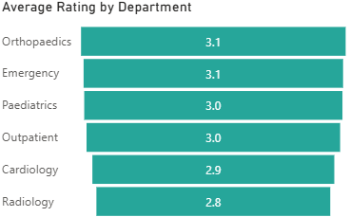
Data Insights (Patient Experience)
About 18% of the feedback suggest a need for improvement.
16% cited long wait time.
Orthopaedics and Emergency have the highest average rating at 3.1.
Radiology is lowest at 2.8

Slide 11
Recommendations
Investigate the cause of delay by conducting a process review to determine whether delays come from late clinic start, registration, or doctor availability.
Standardize clinic workflows.
Implement continuous performance monitoring.
Reduce no-shows and cancellations through active reminders and better appointment-management process.
Review appointment scheduling and capacity allocation based on doctor availability.
Strengthen data quality controls.

Slide 12
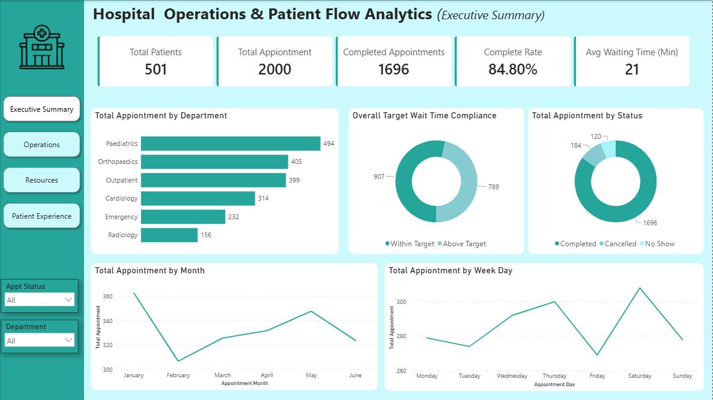

Slide 13
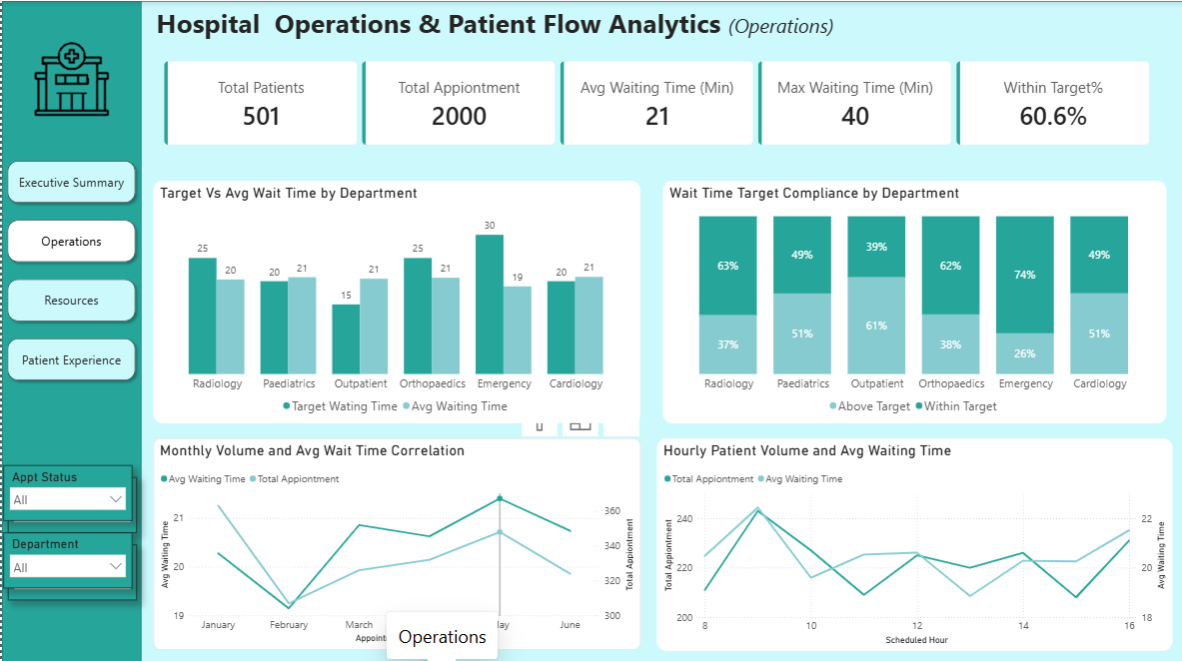

Slide 14
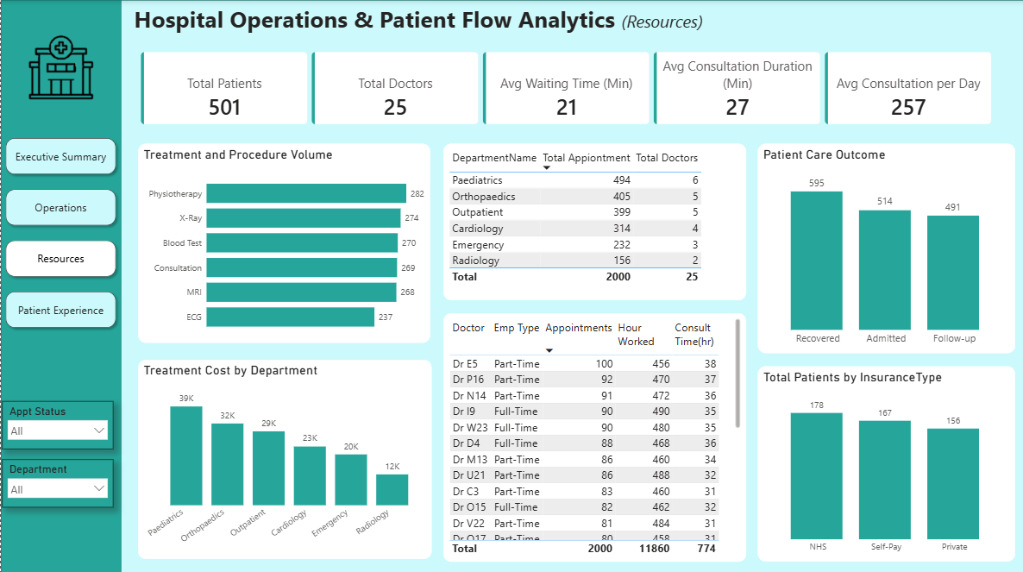

Slide 15
